Slide 1
Search

Slide 2
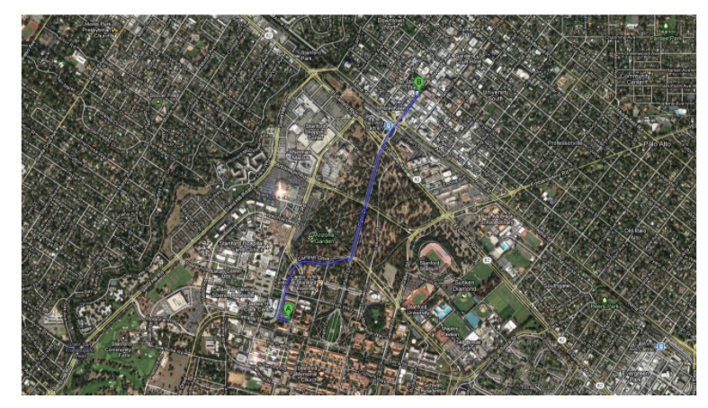
Route Finding
Objective: shortest? fastest? most scenic?
Actions: go straight, turn left, turn right

Slide 3
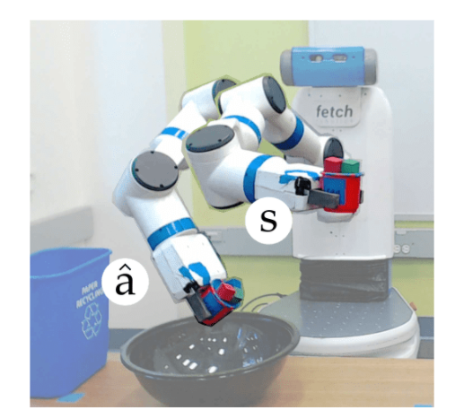
Robot Motion planning
Objective: fastest? most energy efficient? safest? most expressive?
Actions: translate and rotate joints

Slide 4
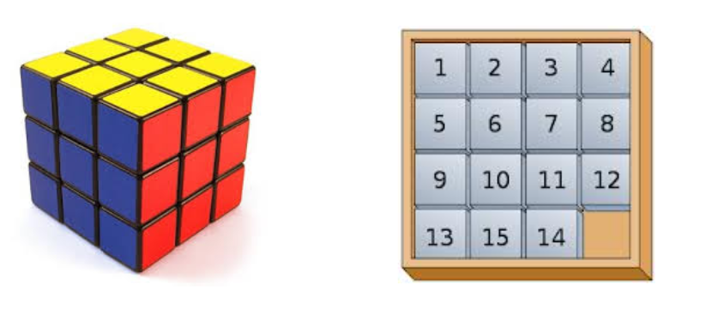
Solving Puzzles
Objective: reach a certain configuration
Actions: move pieces (e.g., Move12Down)

Slide 5
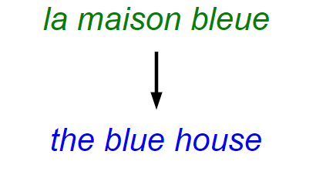
Machine Translation
Objective: fluent English and preserves meaning
Actions: append single words (e.g., the)

Slide 6
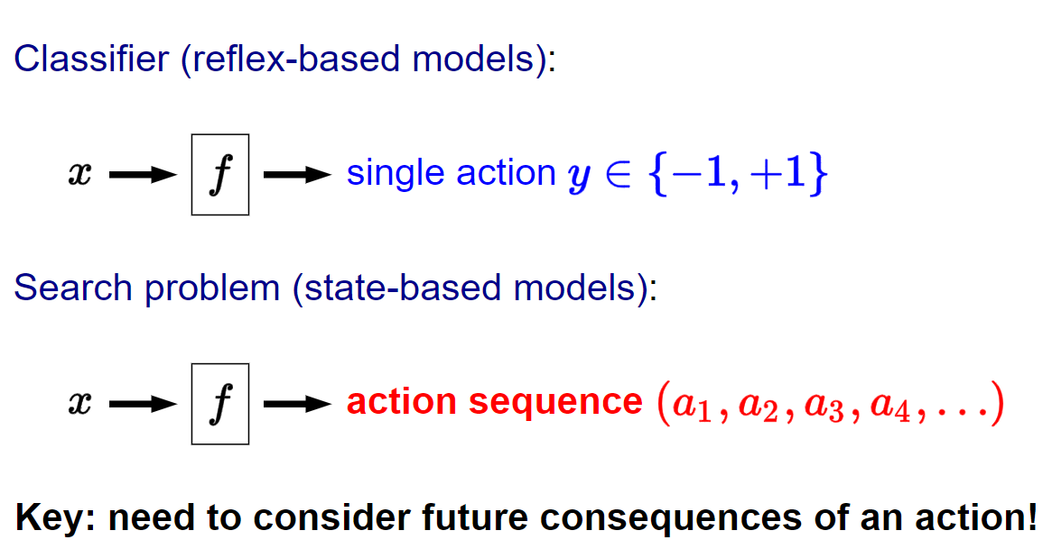
Reflex agent Vs Goal based agent
(Goal based Agent)

Slide 7
Reflex agent Vs Goal based agent
Reflex-based models - Machine Learning Models
(e.g., linear predictors and neural networks) that output either 0 or 1
(for binary classification) or a real number (for regression).
reflex-based models - suitable - sentiment classification
spam filtering etc.,
But applications such as solving puzzles, demand more.
Search problems - Goal based Agent - we build a predictor which takes an input , but will return an entire action sequence, not just a single action. .

Slide 8
Problem Solving
Formulate the problem
Solve it by search through the state space
Explicit search trees/search graph

Slide 9

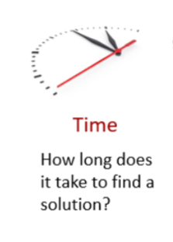

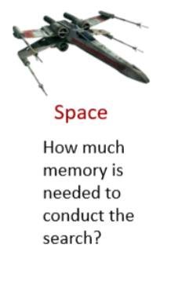
Measures of performance

Slide 10
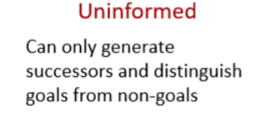

Search Strategies
Uninformed search / Blind search
Informed search / Heristic search

Slide 11
Uninformed search strategies
We have no clue whether one non-goal state is better than any other.
Search is blind.
We don’t know if your current exploration is likely to be fruitful.
Various blind strategies
Breadth-first search
Uniform-cost search
Depth-first search
Iterative deepening search

Slide 12
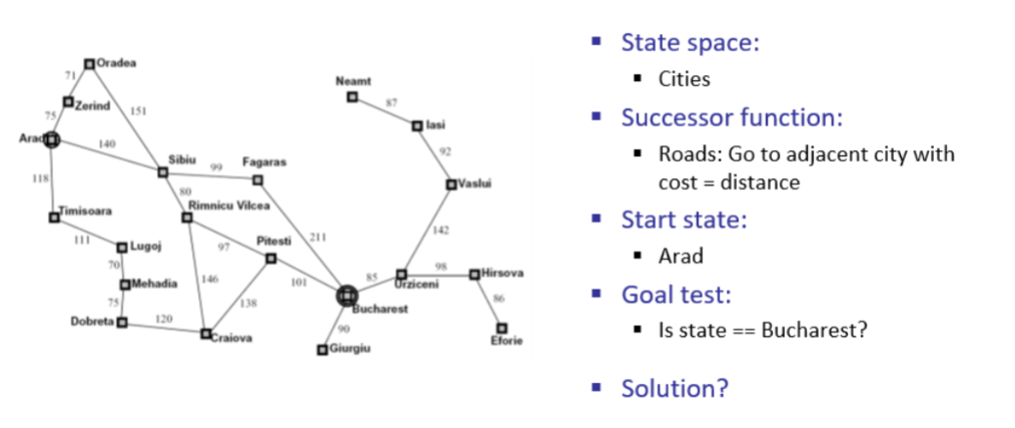
Travelling in Romania

Slide 13
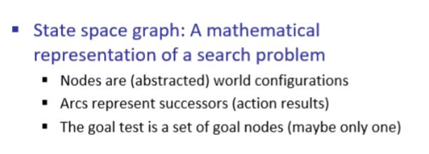
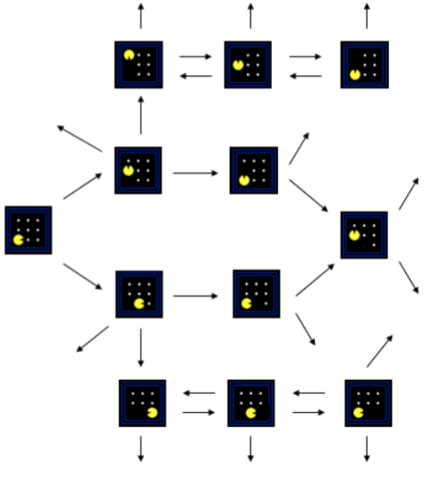


State Space Graph

Slide 14
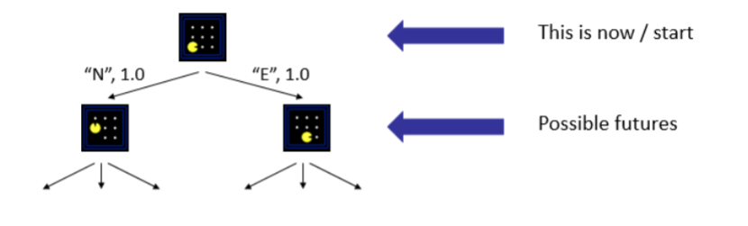
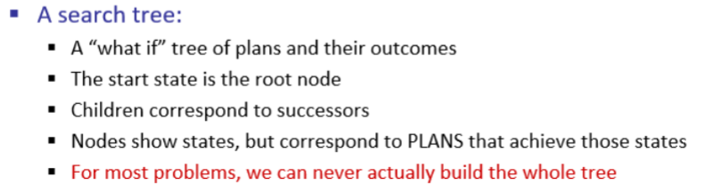
Search Trees

Slide 15
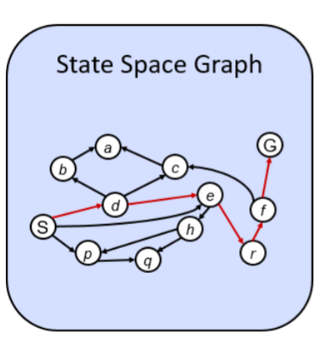
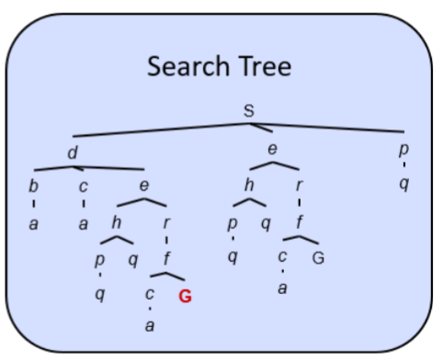
Search Graph Vs Search Tree

Slide 16
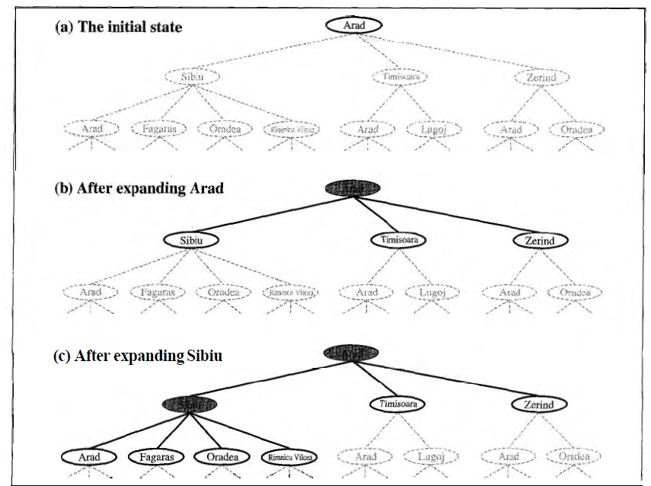
Nodes that have been expanded are shaded;
nodes that have been generated but not yet expanded are outlined in bold;
nodes that have not yet been generated are shown in faint dashed lines.
Partial search trees for finding a route from Arad to Bucharest.

Slide 17
General Search Tree algorithm
Function TREE SEARCH(strategy) returns ,a solution, or failure
initialize the search tree using the initial state of problem
loop do
if there are no candidates for expansion then return failure
choose a leaf node for expansion according to strategy
if the node contains a goal state
then return the corresponding solution
else expand the node and add the resulting nodes to the search tree

Slide 18
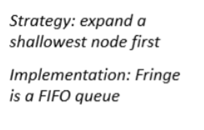
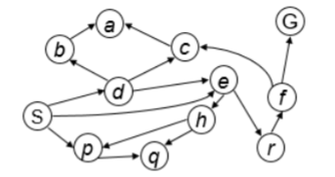
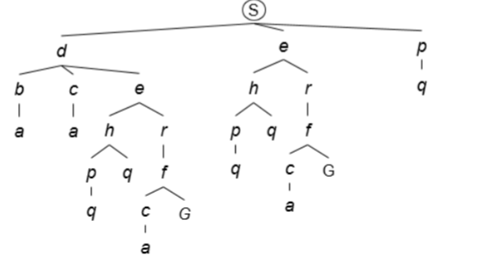
Breadth-first Search

Slide 19
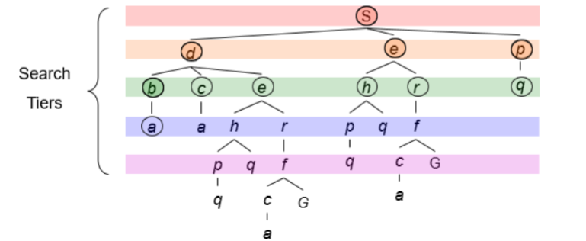
Breadth-first Search

Slide 20
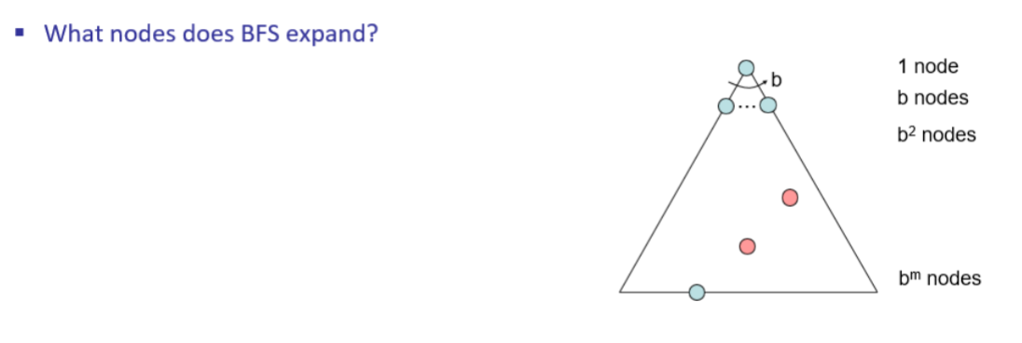

Slide 21
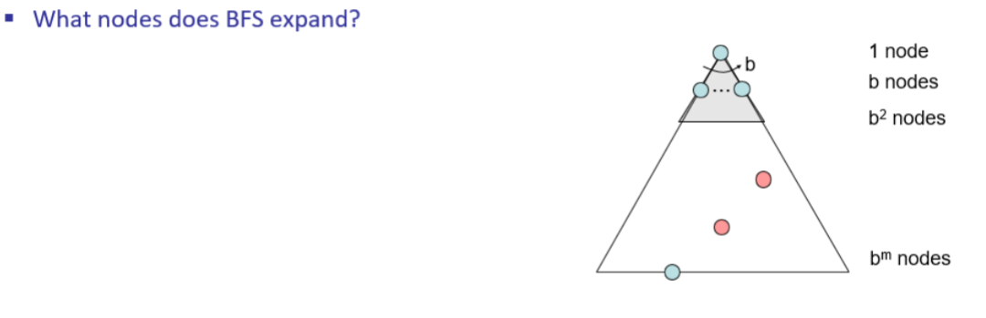

Slide 22
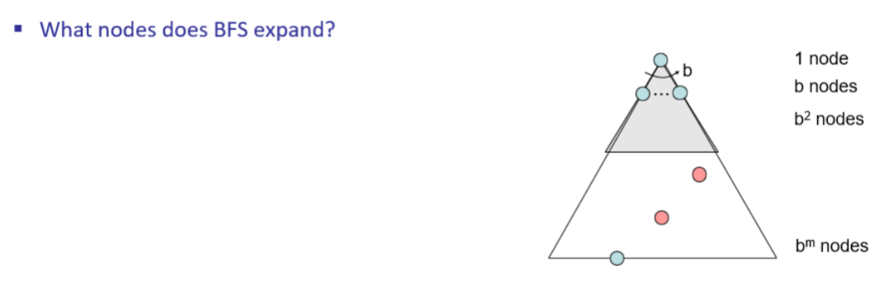

Slide 23
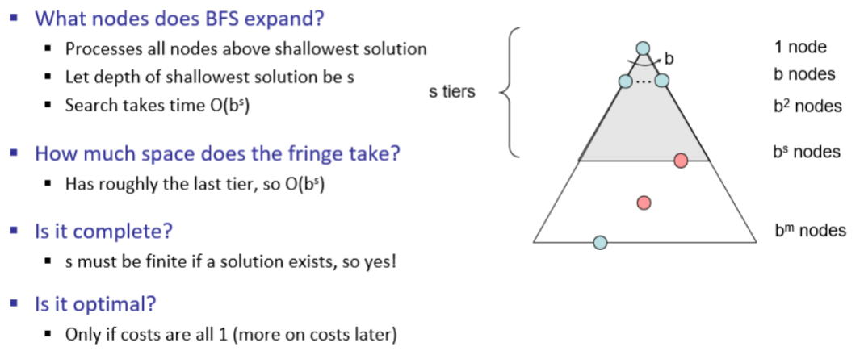

Slide 24
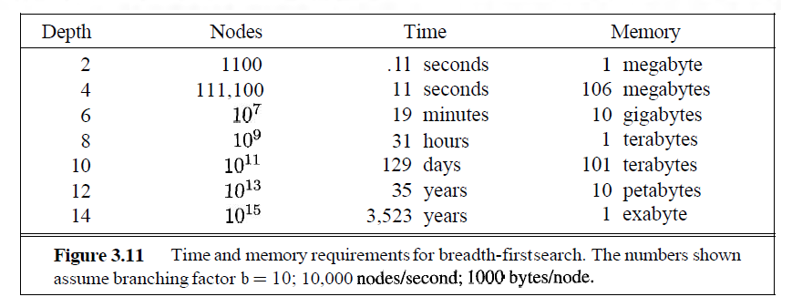
The table assumes that 10,000 nodes can be generated per second and that a node requires 1000 bytes of storage

Slide 25
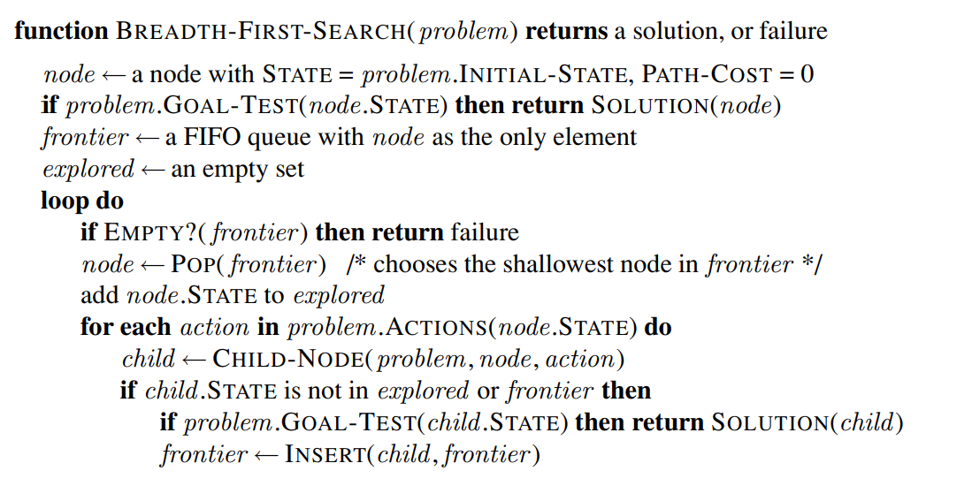
BFS Graph Search

Slide 26
Uniform Cost Search
BFS finds the shallowest goal state.
Uniform cost search modifies the BFS by expanding ONLY the lowest cost node (as measured by the path cost g(n))
The cost of a path must never decrease as we traverse the path, ie. no negative cost should in the problem domain
This is done by storing the frontier as a priority queue ordered by g

Slide 27
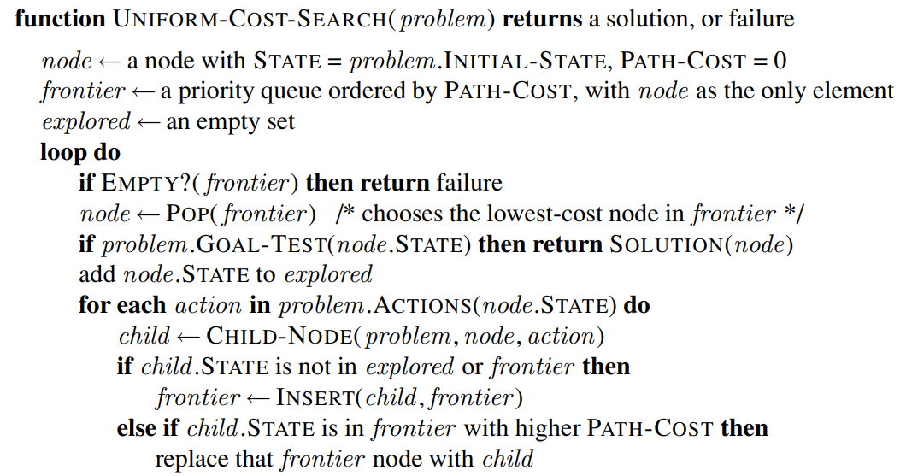
Uniform Cost Search

Slide 28
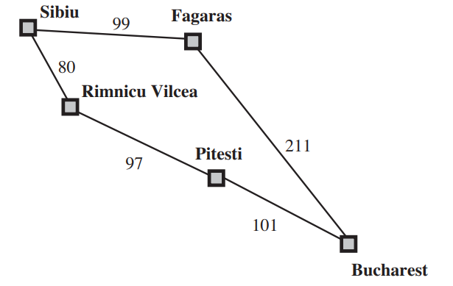
In addition to the ordering of the queue by path cost, there are two other significant differences from breadth-first search.
The goal test is applied to a node when it is selected for expansion rather than when it is first generated.
Problem is to get from Sibiu to Bucharest
2. A test is added in case a better path is found to a node currently on the frontier

Slide 29
Problem is to get from Sibiu to Bucharest
The successors of Sibiu are Rimnicu Vilcea and Fagaras, with costs 80 and 99, respectively
The least-cost node, Rimnicu Vilcea, is expanded next, adding Pitesti with cost 80 + 97 = 177
The least-cost node is now Fagaras, so it is expanded, adding Bucharest with cost 99 + 211 = 310
UCS keeps going, choosing Pitesti for expansion and adding a second path to Bucharest with cost 80+ 97+ 101 = 278.
Now the algorithm checks to see if this new path is better than the old one; it is, so the old one is discarded. Bucharest, now with g-cost 278, is selected for expansion and the solution is returned

Slide 30
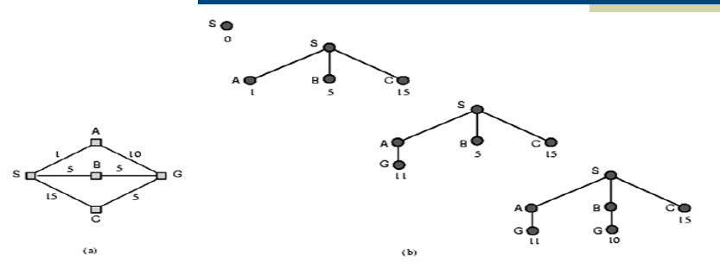
Uniform Cost Search

Slide 31
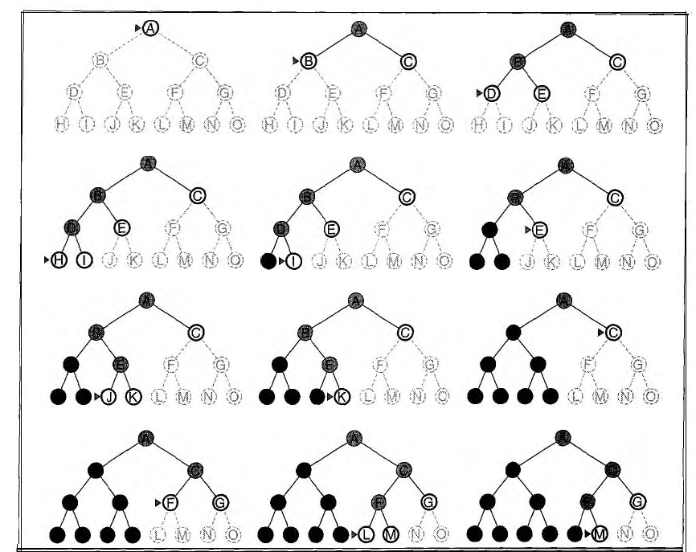
Depth-first Search
Depth-first search always expands the deepest node in the current fringe of the search tree
last-in-first-out (LIFO) -- Stack
Depth-first search with a recursive function

Slide 32
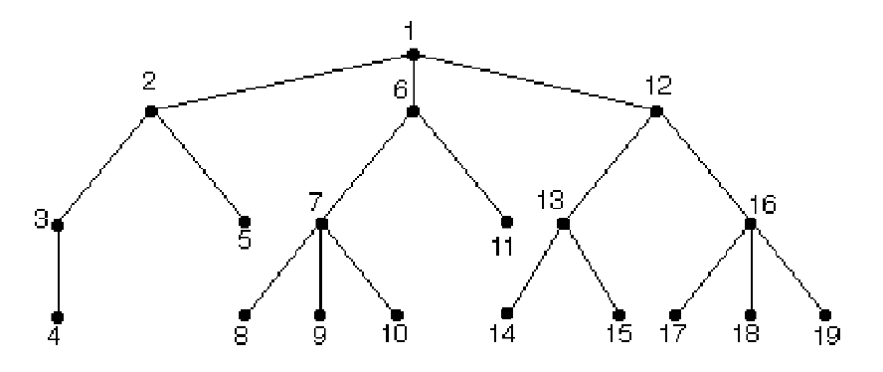
Depth First Search

Slide 33
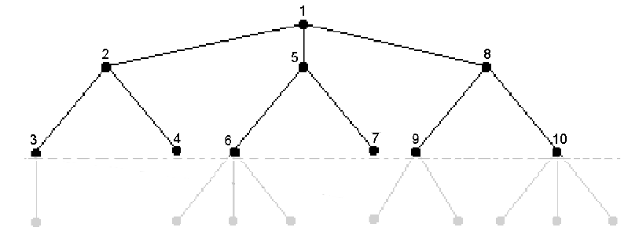
Depth Limited Search
“Practical” DFS
⬥ DLS avoids the pitfalls of DFS by imposing a cutoff on the maximum depth of a path.
⬥ However, if we choose a depth limit that is too small, then DLS is not even complete.
⬥ The time and space complexity of DLS is similar to DFS

Slide 34
Iterative Deepening Search
The hard part about DLS is picking a good limit.
IDS is a strategy that sidesteps the issue of choosing the best depth limit by trying all possible depth limits: first depth 0, then depth 1, the depth 2, and so on

Slide 35
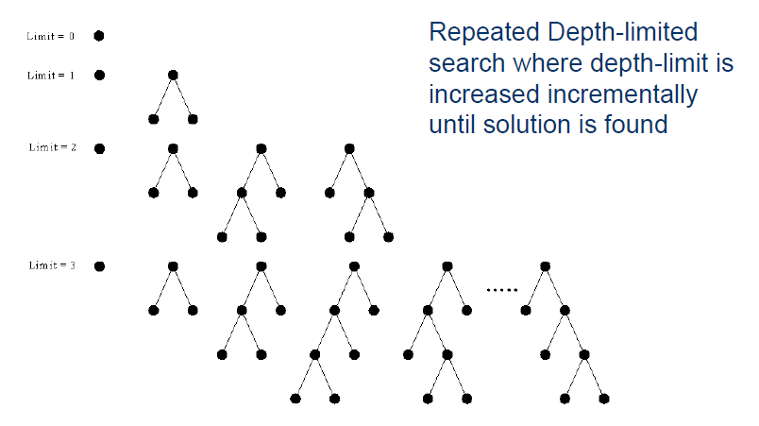
Iterative Deepening Search

Slide 36
Bi-directional Search

Slide 37
Search forward from the Initial state
And search backwards from the Goal state.
Stop when they meet in the middle
good??; When can you do such a search??
Each search checks each node before it is expanded to see if it is in the fringe of the other search.

Slide 38
Comparing blind search techniques
b - branching factor;
d is the depth of the solution;
m is the maximum depth of the search tree;
l is the depth limit

